Slide 1

Modifying a Database
Modifying a database
SQL action queries: insert, update, delete
Committing changes

Slide 2
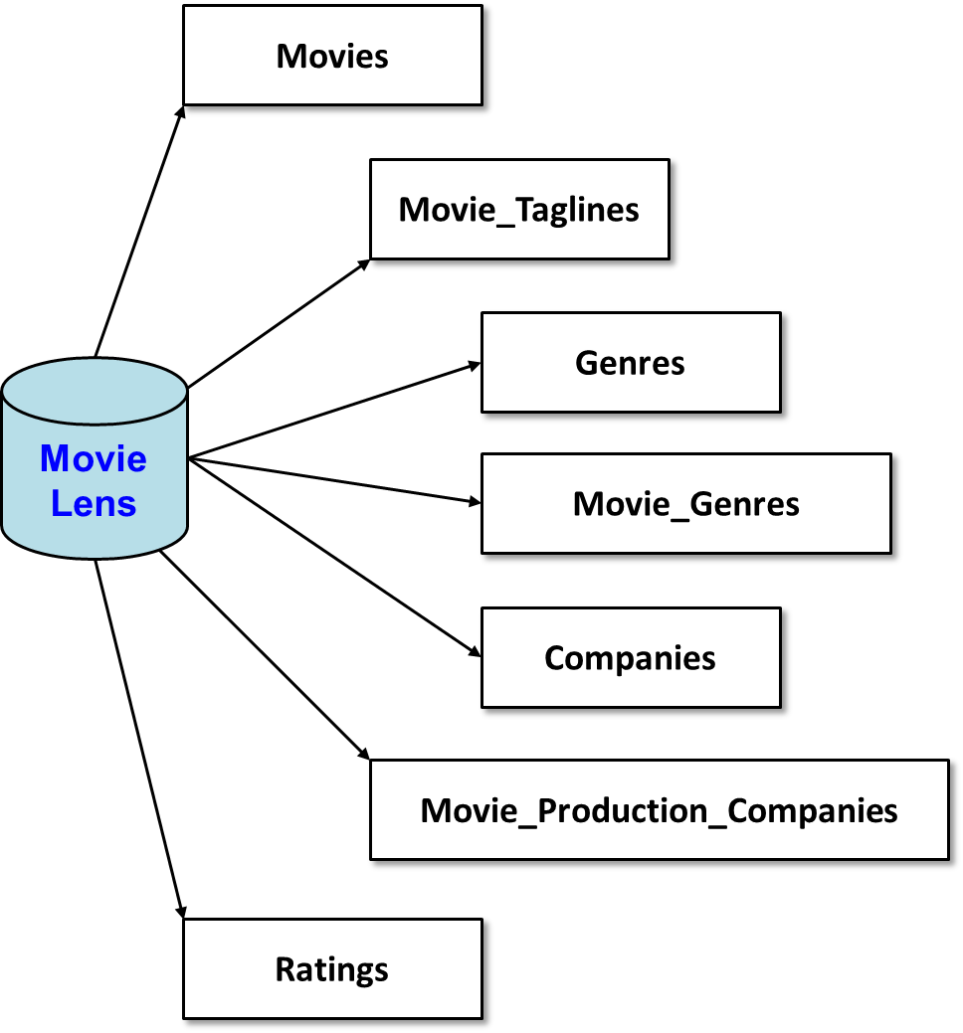
MovieLens database
MovieLens
https://movielens.org/
45K movies
26M reviews

Slide 3
Action queries
Action queries modify a database
Most common forms:
Insert
Update
Delete
INSERT INTO tablename(column1, column2, …)
VALUES(value1, value2, …);
UPDATE tablename
SET column1 = newvalue1, column2 = newvalue2, …
[ WHERE condition ] ;
DELETE FROM tablename
[ WHERE condition ] ;
Be careful! If you omit the “where” clause, updates/deletes all rows in the table!

Slide 4
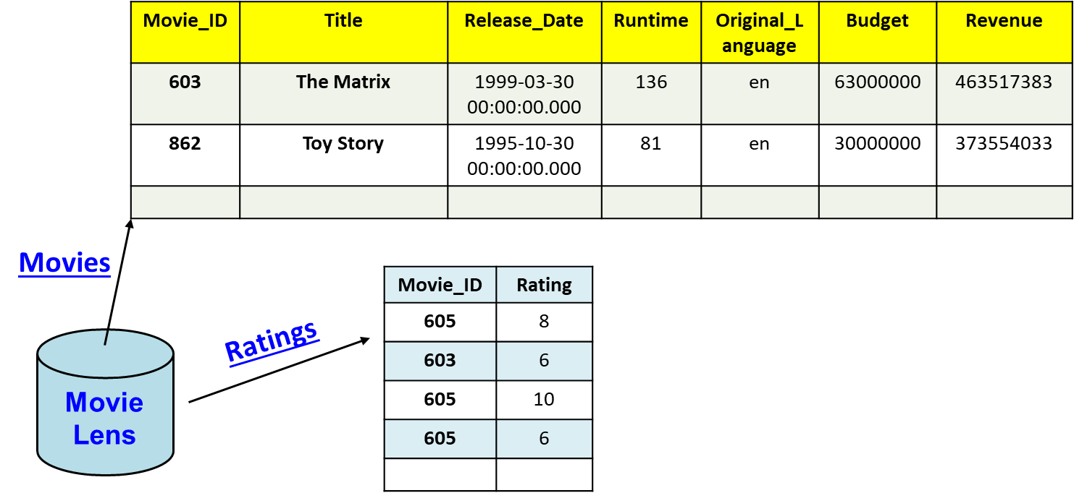
Example
Insert a new review…
INSERT INTO Ratings(Movie_ID, Rating)
VALUES(603, 10);
Notes:
To demo violating foreign key constraint in SQLite, you have to enable the checking:
PRAGMA foreign_keys = ON;
insert into Ratings(Movie_ID, Rating) values(123456789, 10);

Slide 5

Executing SQL from Python
Database server
SELECT * FROM ...;
Database

Slide 6
Example
Insert a new review…
import sqlite3
dbConn = sqlite3.connect("movielens.db")
dbCursor = dbConn.cursor()
rating = input("What rating do you give 'The Matrix'? ")
# insert rating:
sql = """
insert into ratings(movie_id, rating) values(603, ?);
"""
dbCursor.execute(sql, [rating])
inserted = dbCursor.rowcount
print("Rows inserted:", inserted)
This doesn't work --- the changes aren't saved?!?!

Slide 7


Slide 8
Commit your changes
You need to commit (save) your changes, or rollback (undo) your changes
import sqlite3
dbConn = sqlite3.connect("movielens.db")
dbCursor = dbConn.cursor()
rating = input("What rating do you give 'The Matrix'? ")
# insert rating:
sql = """
insert into ratings(movie_id, rating) values(603, ?);
"""
dbCursor.execute(sql, [rating])
inserted = dbCursor.rowcount
if inserted > 0:
dbConn.commit()
else:
dbConn.rollback()

Slide 9
Data tier
Data
Tier.py

Slide 10
Executing actions (insert, update, delete)
sql = "INSERT INTO Ratings(Movie_ID, Rating) VALUES(603, 10);"
added = datatier.perform_action(dbConn, sql)
if added != 1:
print("error!")
#
# perform_action: executes action query and returns the # of
# rows modified; returns -1 on an error.
#
def perform_action(dbConn, sql, parameters=[]):
dbCursor = dbConn.cursor()
try:
# try to execute, and if successful commit the changes
# and return the # of rows modified by the query:
dbCursor.execute(sql, parameters)
dbConn.commit()
return dbCursor.rowcount
except Exception as e:
# if it fails, print an error msg and return -1:
dbConn.rollback()
logging.error('perform_action failed:')
logging.error(e)
return -1
finally:
# cleanup code that gets executed either way:
dbCursor.close()

Slide 11
That's it, thank you!

Slide 12
Movies
Movie_Taglines
Genres
Movie Lens
Movie_Genres
Companies
Movie_Production_Companies
Ratings

Slide 13
Movie_ID | Title | Release_Date | Runtime | Original_Language | Budget | Revenue
603 | The Matrix | 1999-03-30 00:00:00.000 | 136 | en | 63000000 | 463517383
862 | Toy Story | 1995-10-30 00:00:00.000 | 81 | en | 30000000 | 373554033
Movies
Movie_ID | Tagline
603 | Welcome to the Real World.
605 | Everything that has a beginning has an end.
Movie_Taglines
Movie Lens
Ratings
Movie_ID | Rating
605 | 8
603 | 6
605 | 10
605 | 6

Slide 14
Company_ID | Company_Name
1885 | Silver Pictures
6194 | Warner Bros.
Movie_ID | Company_ID
603 | 1885
603 | 6194
862 | 3
Companies
Movie_Production_Companies
Movie_ID | Genre_ID
862 | 16
862 | 35
603 | 28
603 | 878
Movie Lens
Movie_Genres
Genres
Genre_ID | Genre_Name
28 | Action
878 | Science Fiction
16 | Animation
35 | Comedy

Slide 15

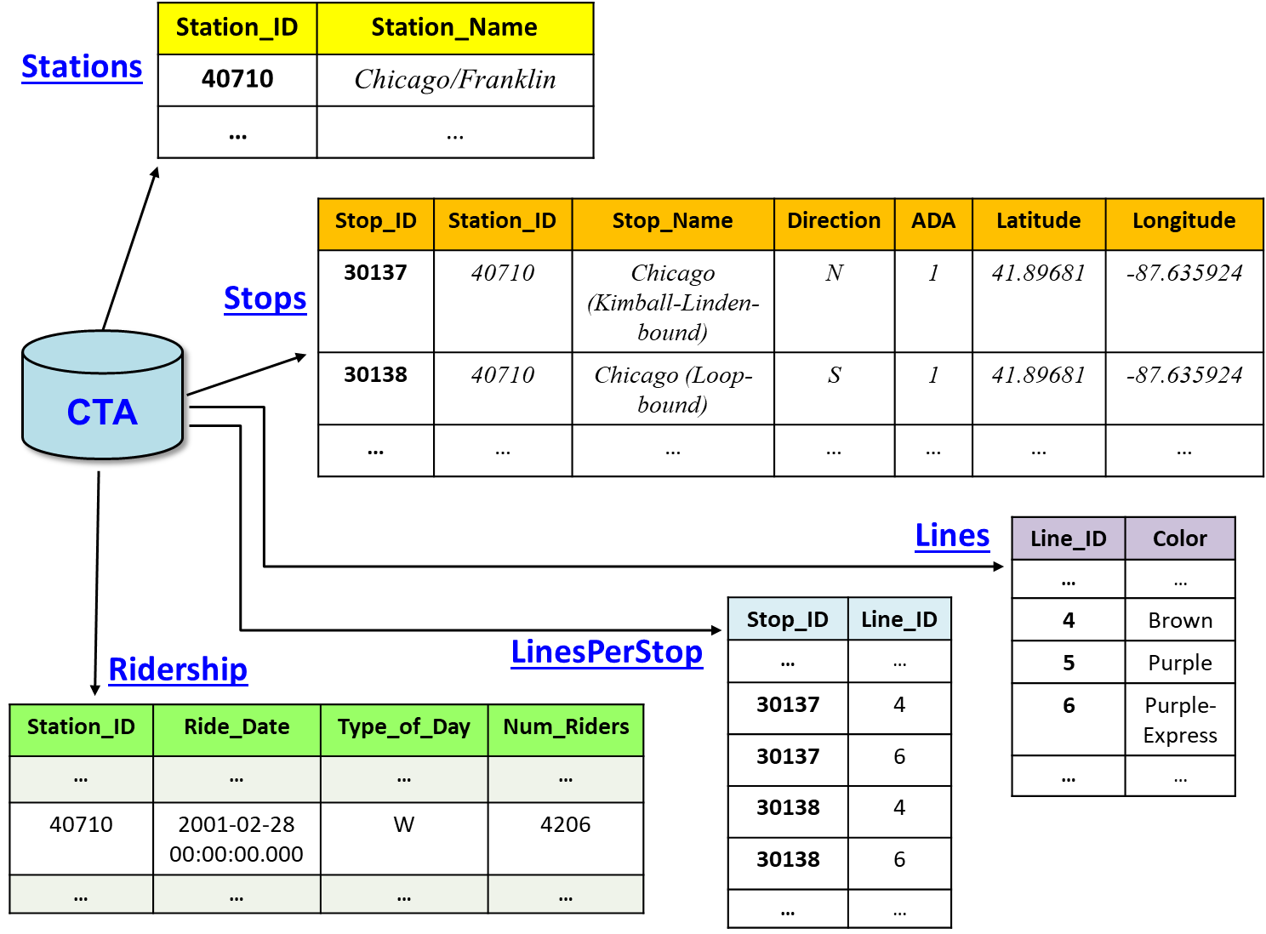
CTA database

